Slide 1

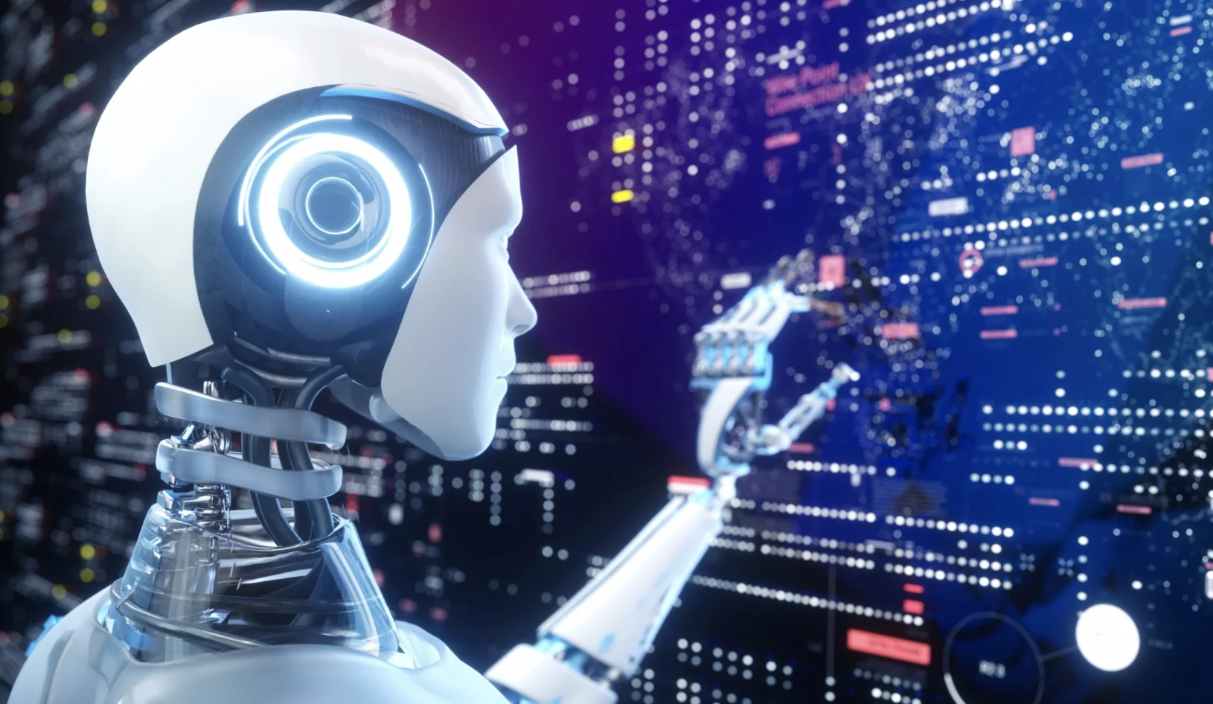
AI in Business Future Applications Presented By Brian Byrne MSc.

Slide 2
AI – Question for class…
QUESTION FOR CLASS:
How does AI affect all our lives currently?

Slide 3
AI – We use it daily already!
Answer: Currently, AI interacts with us in many ways
Social feeds are tuned to our preferences
Netflix and other apps suggest our favourite shows
Medical diagnostics are screened by computers
Email is categorized into Junk, important
Education has new tools for learning.
(i.e ChatGPT, BARD)

Slide 4
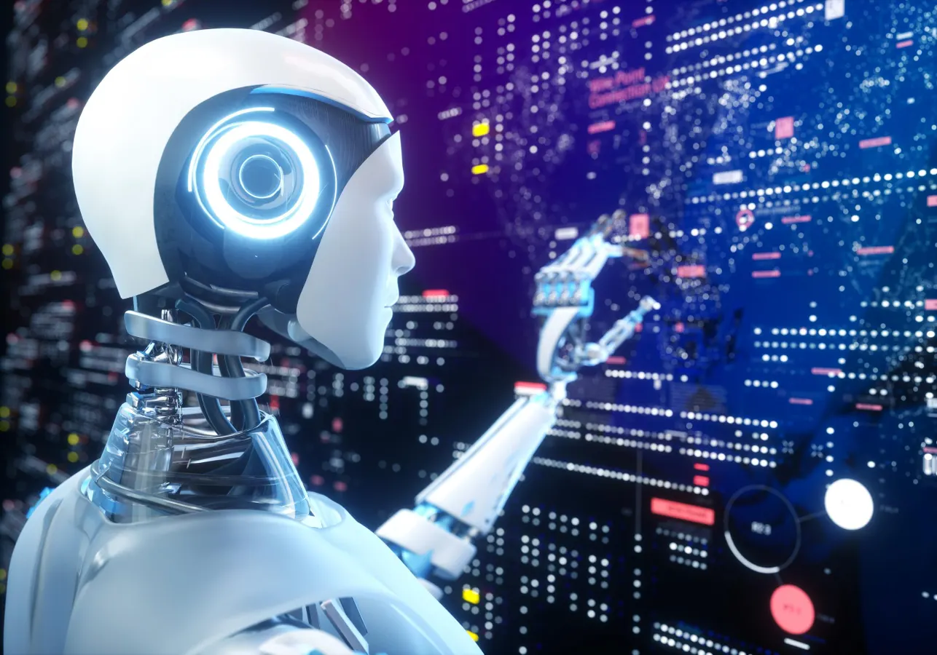
Overview of Current AI Technologies
Machine Learning and Deep Learning
Natural Language Processing
Computer Vision
Robotics
Expert Systems

Slide 5
Applications in Different Sectors
Healthcare | Drug Discovery and Development: AI is being used to accelerate the drug discovery and development process, by identifying potential drug candidates, predicting their efficacy and safety, and designing clinical trials. Personalized Medicine: AI is being used to develop personalized medicine approaches, by analyzing patient data to tailor treatments to individual patients' needs and risk factors. Medical Imaging Analysis: AI is being used to analyze medical images, such as X-rays, CT scans, and MRIs, to identify abnormalities and assist in diagnosis.
Finance | Fraud Detection: AI is being used to detect fraudulent transactions in financial systems, by identifying patterns and anomalies in financial data. Algorithmic Trading: AI is being used to develop algorithmic trading strategies that can make automated decisions based on market data and analysis. Risk Management: AI is being used to assess and manage financial risks, by analyzing data and identifying potential risks and opportunities.
Transportation | Self-Driving Vehicles: AI is being used to develop self-driving vehicles that can navigate roads and traffic without human intervention. Traffic Management: AI is being used to optimize traffic flow and reduce congestion, by analyzing traffic patterns and predicting demand. Predictive Maintenance: AI is being used to predict and prevent equipment failures in transportation systems, by analyzing sensor data and identifying anomalies.
Education | Personalized Learning: AI is being used to personalize learning experiences for individual students, by adapting instruction to their needs and learning styles. Intelligent Tutoring Systems: AI is being used to develop intelligent tutoring systems that can provide personalized feedback and support to students. Automated Assessment: AI is being used to automate the assessment of student work, providing teachers with valuable insights into student progress.
Retail | Product Recommendations: AI is being used to recommend products to customers based on their past purchases, browsing behavior, and preferences. Demand Forecasting: AI is being used to forecast demand for products, helping retailers optimize inventory levels and reduce stockouts. Customer Service Chatbots: AI-powered chatbots are being used to provide customer service, answering questions and resolving issues.

Slide 6
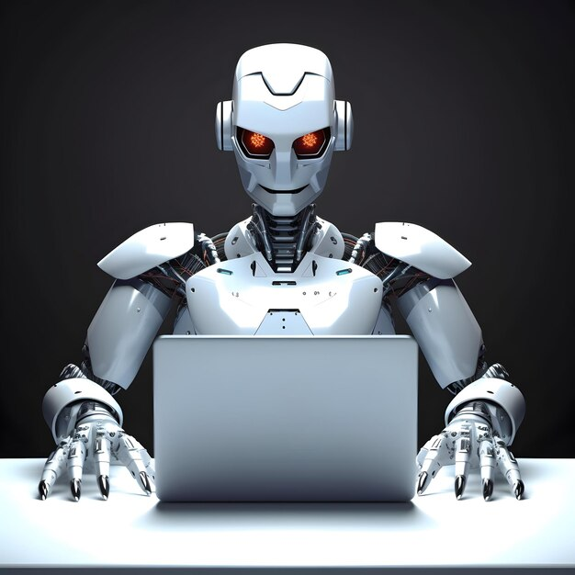
Challenges of AI
Bias and Fairness: AI systems are trained on data that reflects the biases of the real world. These biases can be amplified in AI algorithms, leading to unfair and discriminatory outcomes. For example, an AI system used for hiring might favor certain demographic groups over others, perpetuating existing inequalities.
Explainability and Transparency: Many AI systems are complex and opaque, making it difficult to understand how they make decisions. This lack of transparency can lead to concerns about accountability and potential misuse. For instance, an AI system used for criminal justice might flag certain individuals for further scrutiny without providing clear explanations for its decisions.
Privacy and Security: AI systems often collect and process vast amounts of personal data. This raises concerns about privacy and the potential for misuse of this data. AI systems could be used to track individuals, monitor online activity, or even manipulate behavior.
Accountability and Responsibility: When AI systems make mistakes or cause harm, it is not always clear who is responsible. This can lead to challenges in holding individuals or organizations accountable for the consequences of AI.

Slide 7
What is Bias
Bias in AI, also known as machine learning bias or algorithmic bias, refers to the tendency of AI systems to reflect human biases in the data they are trained on. These biases can lead to unfair and discriminatory outcomes, particularly for marginalized groups.
Sources of Bias in AI
Biased Data: When AI systems are trained on biased data, they learn to perpetuate and amplify those biases in their predictions and decisions. This can happen when data is collected from biased sources, such as social media or historical records, or when data is not properly cleaned and filtered to remove bias.
Algorithmic Design: Bias can also be introduced during the design of AI algorithms. For example, if an algorithm is designed to prioritize certain features over others, it may unintentionally favor certain groups of people.
Human Oversight: Even with unbiased data and algorithms, bias can still creep in through human oversight. For instance, if the developers and maintainers of an AI system are not aware of potential biases, they may not take steps to mitigate them.

Slide 8
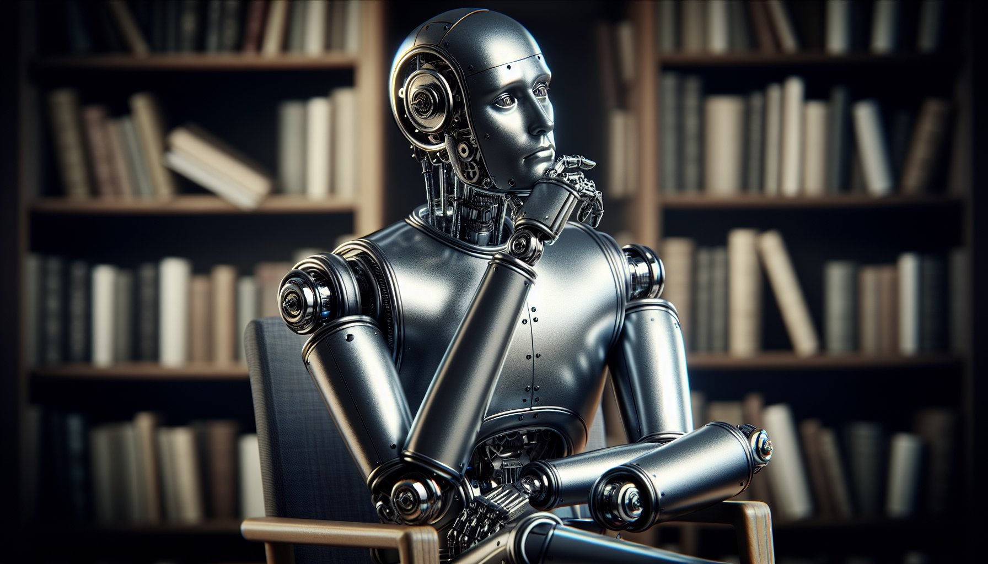
Ethical Considerations
Human Control and Autonomy: AI should be developed and used in a way that respects human autonomy and control. We should not create AI systems that can make decisions without human oversight or that could pose a threat to human control.
Benefit to Society: AI should be used for the benefit of humanity and should not cause harm. We should avoid developing AI systems that could be used for malicious purposes, such as autonomous weapons or systems that could manipulate or exploit people.
Justice and Fairness: AI should be used in a fair and just manner. We should strive to develop AI systems that do not discriminate or perpetuate existing inequalities.
Privacy and Confidentiality: AI should respect the privacy and confidentiality of individuals. We should ensure that AI systems collect and use data in a responsible and ethical manner.
Reliability and Safety: AI systems should be reliable and safe. We should take steps to mitigate the risks of AI systems causing harm or making mistakes.
Social and Economic Impact: We should consider the potential social and economic impacts of AI, both positive and negative. We should develop policies and strategies to mitigate potential negative impacts and ensure that AI is used for the benefit of society as a whole.
Transparency and Explainability: AI systems should be transparent and explainable. We should strive to develop AI systems that can explain their decisions in a way that is understandable to humans.
Accountability and Responsibility: We should establish clear lines of accountability and responsibility for AI systems. We should ensure that individuals and organizations are held accountable for the consequences of their AI systems.

Slide 9
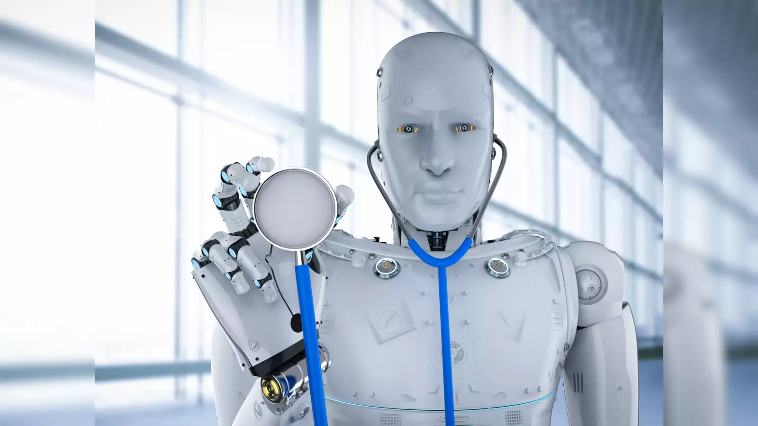
Is AI Smarter than humans ?
QUESTION:
Is AI smarter than humans ?

Slide 10
AI – Is it smarter than humans ?
Whether AI is smarter than humans is a complex question that depends on how you define intelligence
In terms of narrow intelligence, which is the ability to perform specific tasks, AI has surpassed humans in some areas. For example, AI can now beat humans at chess, Go, and other complex games. AI can also translate languages more accurately than humans, and it can generate creative text, like poems and code.
In terms of general intelligence, which is the ability to reason, solve problems, and learn in a wide range of domains, humans still outperform AI. AI is still limited by its training data, and it can struggle to generalize to new situations. AI lacks the common sense and understanding of the world.
Too early to say definitively whether AI is smarter than humans! Some reasons why humans are still smarter than AI are:
Humans have a lifetime of experience and learning.
Humans can adapt to new situations.
Humans have common sense and understanding of the world
AI is a powerful tool that can be used to solve a wide range of problems. As AI research continues, we can expect to see even more impressive results.

Slide 11
Advancements in AI
Large Language Models (LLMs): | LLMs like GPT-3, LaMDA, and Bloom have revolutionized natural language processing (NLP) by generating human-quality text, translating languages, writing different kinds of creative content, and answering questions in an informative way. These models are trained on massive datasets of text and code, allowing them to learn complex patterns and relationships in language.
Computer Vision: | AI-powered computer vision systems have become increasingly sophisticated, enabling machines to perceive and interpret the visual world with remarkable accuracy. This progress has led to advancements in object detection, image recognition, facial recognition, and autonomous vehicles.
Reinforcement Learning (RL): | RL algorithms are becoming more powerful and versatile, enabling agents to learn complex tasks through trial and error. This has opened up new possibilities for AI applications in robotics, game playing, resource management, and drug discovery.
Explainable AI (XAI): | Researchers are making progress in developing XAI techniques that make AI models more transparent and understandable. This is crucial for building trust in AI systems and ensuring that they are unbiased and fair.
AI for Healthcare: | AI is transforming healthcare by assisting with medical diagnosis, treatment planning, drug discovery, and personalized medicine. AI-powered systems can analyze medical images, patient data, and genetic information to provide insights that improve patient care.
AI for Climate Change: | AI is being used to address climate change challenges, such as optimizing energy use, predicting extreme weather events, and developing sustainable solutions for agriculture and transportation.
AI for Education: | AI is personalized learning experiences for individual students, providing adaptive instruction, intelligent tutoring systems, and automated assessment tools.
AI for Retail: | AI is enhancing retail experiences by providing personalized product recommendations, optimizing inventory management, and improving customer service through chatbots and virtual assistants.

Slide 12
Large Language Models, LLM
Large language models (LLMs) are a powerful type of artificial intelligence (AI) that have revolutionized natural language processing (NLP). These models are trained on massive datasets of text and code, allowing them to learn complex patterns and relationships in language.
LLMs can generate human-quality text, translate languages, write different kinds of creative content, and answer questions in an informative way.
Characteristics of LLMs:
Large Size: LLMs are trained on massive amounts of data, typically containing billions or trillions of words. This allows them to learn a rich representation of human language.
Neural Network Architecture: LLMs typically use a type of neural network called a transformer, which is well-suited for processing long sequences of text.
Self-Supervised Learning: Many LLMs are trained using self-supervised learning techniques, which means that they do not require explicit labels or instructions. Instead, they learn by predicting the next word in a sequence or by reconstructing a corrupted sentence.

Slide 13
LLMs Application
LLMs have a wide range of applications, including:
Natural Language Generation (NLG): LLMs can generate human-quality text, such as news articles, poems, code, scripts, musical pieces, email, letters, etc.
Machine Translation (MT): LLMs can translate languages more accurately than traditional MT methods, especially for complex or nuanced language.
Question Answering (QA): LLMs can answer questions in an informative way, even if they are open ended, challenging, or strange.
Chatbots: LLMs can be used to create chatbots that can hold conversations with humans in a natural way.
Creative Writing: LLMs can be used to generate different kinds of creative content, such as poems, code, scripts, musical pieces, email, letters, etc.
Limitations of LLMs:
Bias: LLMs can reflect the biases of the data on which they are trained. This can lead to biased or discriminatory outputs.
Explainability: LLMs can be difficult to explain, which can make it difficult to trust their outputs.
Sample Efficiency: LLMs can require a large amount of data to train, which can be expensive and time-consuming.

Slide 14

LLM DEMO – CORVINUS UNIVERSITY POEM

Slide 15
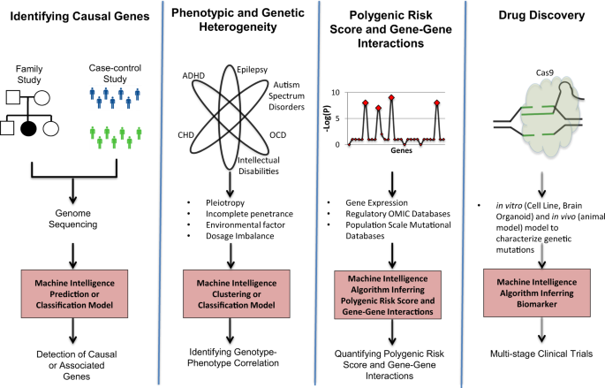
AI in Healthcare
Disease Diagnosis/Prediction
Drug Discovery
Personalized Medicine
Precision Medicine

Slide 16
AI in Personalized Medicine
Patient Stratification: AI can analyze patient data, including genetic, clinical, and lifestyle factors, to identify subgroups of patients likely to respond to specific treatments.
Treatment Selection: AI can recommend personalized treatment regimens based on individual patient characteristics, optimizing treatment efficacy and minimizing side effects.
Predicting Patient Outcomes: AI can predict patient outcomes, such as response to treatment, risk of adverse events, and survival, aiding in treatment planning and patient counseling.
Drug Dosage Optimization: AI can optimize drug dosages for individual patients, considering factors such as age, weight, and genetic makeup to maximize therapeutic effects and minimize risks.

Slide 17
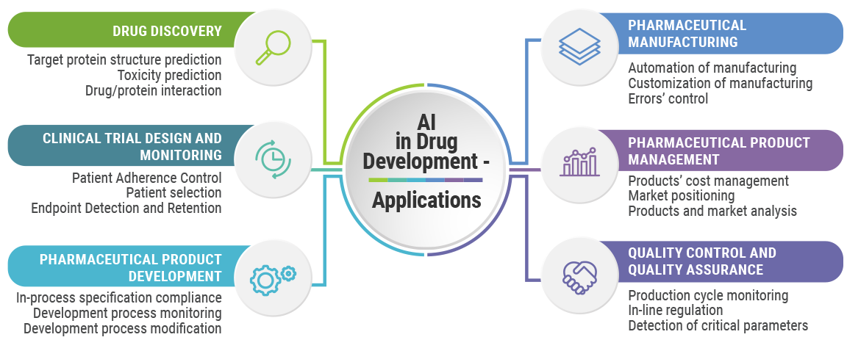
AI in Drug Discovery Discovery
Target Identification: AI algorithms can analyze genomic, proteomic, and other biological data to identify potential drug targets, the molecules involved in disease processes.
Drug Design: AI can design new drug candidates by predicting the molecular structure of compounds that can interact with target molecules and inhibit their activity.
Virtual Screening: AI can virtually screen millions of compounds to identify potential drug candidates with the desired properties, such as efficacy, safety, and specificity.
Predicting Drug Properties: AI can predict the properties of drug candidates, such as their absorption, distribution, metabolism, excretion, and toxicity (ADMET), reducing the need for expensive and time-consuming animal testing.

Slide 18
AI in Precision Medicine
AI in Precision Medicine:
Genetic Analysis: AI algorithms can analyze genomic data to identify genetic variants that contribute to disease risk or influence treatment response.
Biomarker Discovery: AI can identify biomarkers, measurable indicators of disease or treatment response, in biological samples such as blood or tissue.
Risk Prediction: AI can predict an individual's risk of developing a particular disease based on their genetic, clinical, and lifestyle factors.
Treatment Response Prediction: AI can predict how an individual is likely to respond to specific treatments, allowing physicians to make informed treatment decisions.
Drug Development: AI is being used to accelerate drug discovery and development by identifying new drug targets, designing personalized therapeutics, and predicting drug efficacy and safety.
Benefits of AI in Precision Medicine:
Improved Treatment Efficacy: Personalized treatment plans based on AI-driven insights can lead to more effective treatment outcomes and reduced side effects.
Reduced Healthcare Costs: Precision medicine can prevent unnecessary treatments and adverse events, potentially reducing healthcare costs.
Enhanced Patient Care: Patients can receive more tailored and effective treatment plans, improving their overall quality of life.
Accelerated Drug Development: AI can streamline the drug discovery process, leading to faster development of new therapies.
Preventive Medicine: AI can identify individuals at high risk of developing certain diseases, enabling preventive measures and early intervention.

Slide 19
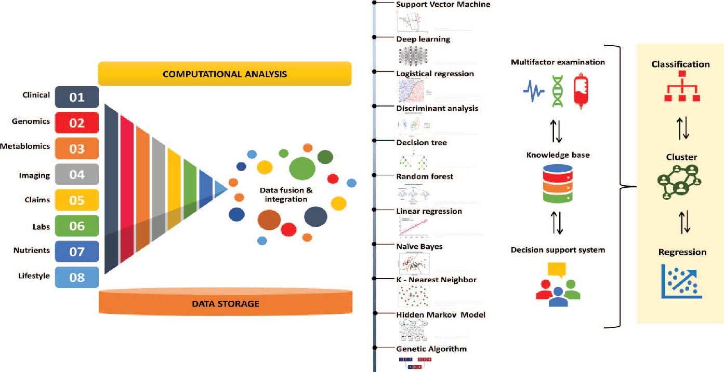
AI in Precision Medicine

Slide 20
AI in Computer Vision
Object Detection: AI algorithms can identify and locate objects within images and videos, such as cars, pedestrians, and traffic signs. This technology is crucial for applications like self-driving cars, image tagging, and security surveillance.
Image Recognition: AI can classify and categorize images based on their content, such as identifying specific objects, scenes, or activities. This capability is essential for applications like image search, content moderation, and medical diagnosis.
Facial Recognition: AI can identify and match faces, enabling applications like face unlocking for smartphones, access control systems, and criminal investigations.
Autonomous Navigation: AI empowers robots and vehicles to navigate their surroundings by interpreting visual information from cameras and sensors. This technology is essential for self-driving cars, drones, and robotic assistants.
Medical Imaging Analysis: AI algorithms can analyze medical images, such as X-rays, CT scans, and MRIs, to assist in diagnosis, treatment planning, and monitoring disease progression.
Augmented Reality: AI enables real-time interaction between the physical world and digital information, enriching user experiences in areas like gaming, education, and training.
Virtual Reality: AI enhances virtual reality experiences by creating realistic and interactive virtual environments, providing immersive experiences for entertainment, training, and simulations.

Slide 21
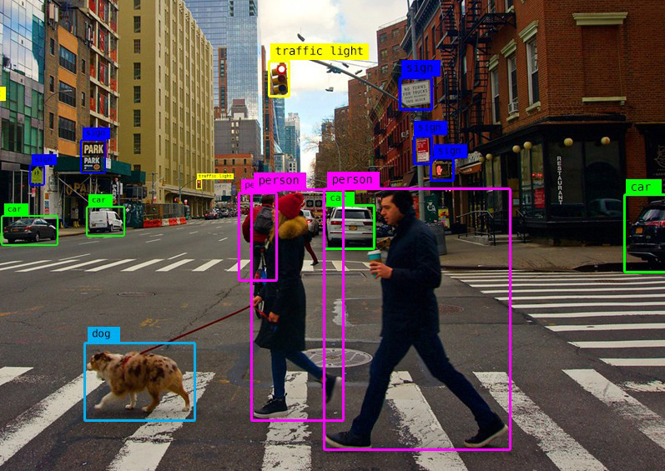

Computer Vision Object Detection

Slide 22
Impact of AI in Computer Vision
Enhanced Human Capabilities: AI extends human capabilities by enabling computers to perform visual tasks with greater accuracy and speed.
Improved Safety and Security: AI-powered systems enhance safety and security in areas like traffic monitoring, autonomous vehicles, and facial recognition-based access control.
Personalized Experiences: AI enables tailored experiences in areas like product recommendations, content curation, and personalized advertising.
Scientific Discoveries: AI facilitates scientific discoveries by analyzing vast amounts of visual data to uncover hidden patterns and insights.
Industrial Automation: AI automates visual inspection tasks in manufacturing, improving productivity and quality control.

Slide 23
AI In Education
Personalized Learning: AI algorithms can analyze student data, including academic performance, learning styles, and interests, to create personalized learning experiences. This includes tailoring instruction, recommending resources, and providing adaptive feedback.
Intelligent Tutoring Systems: AI-powered tutoring systems provide individualized instruction and support to students, offering real-time feedback, answering questions, and adapting to student progress.
Automated Assessment: AI can automate the assessment of student work, providing teachers with valuable insights into student understanding and progress. This includes grading assignments, identifying areas for improvement, and tracking individual student growth.
Chatbots and Virtual Assistants: AI-powered chatbots and virtual assistants can provide students with 24/7 support, answering questions, addressing concerns, and guiding them through educational resources.
Language Learning and Translation: AI-based language learning platforms offer personalized instruction, adaptive exercises, and real-time feedback, enhancing language acquisition and communication skills.
Special Education and Accessibility: AI tools can provide individualized support for students with special needs, such as text-to-speech tools, adaptive learning materials, and personalized instruction.
Predictive Analytics: AI can analyze student data to predict potential academic challenges or areas for improvement, allowing proactive interventions and support.
Educational Content Creation: AI can assist in creating personalized educational content, such as adaptive quizzes, gamified learning experiences, and interactive simulations.
Plagiarism Detection: AI algorithms can detect plagiarism in student work, promoting academic integrity and originality.
Administrative Tasks: AI can automate administrative tasks, such as scheduling, grading, and recordkeeping, freeing up teachers' time to focus on teaching and student interactions.

Slide 24
Impact of AI in Education
Enhanced Learning Outcomes: AI-powered tools can improve student engagement, motivation, and achievement by providing personalized learning experiences, timely feedback, and individualized support.
Increased Teacher Effectiveness: AI can empower teachers to focus on higher-order tasks, such as providing individualized instruction, building relationships with students, and addressing specific learning needs.
Improved Equity and Access: AI can bridge educational gaps and provide equitable access to quality learning experiences for all students, regardless of background or location.
Adaptive to Evolving Needs: AI can adapt to changing educational needs and challenges, providing innovative solutions to emerging issues in education.
Personalized Learning Pathways: AI can facilitate personalized learning pathways, allowing students to progress at their own pace and explore their interests.
Lifelong Learning: AI can support lifelong learning by providing access to personalized learning resources and opportunities throughout an individual's life.

Slide 25
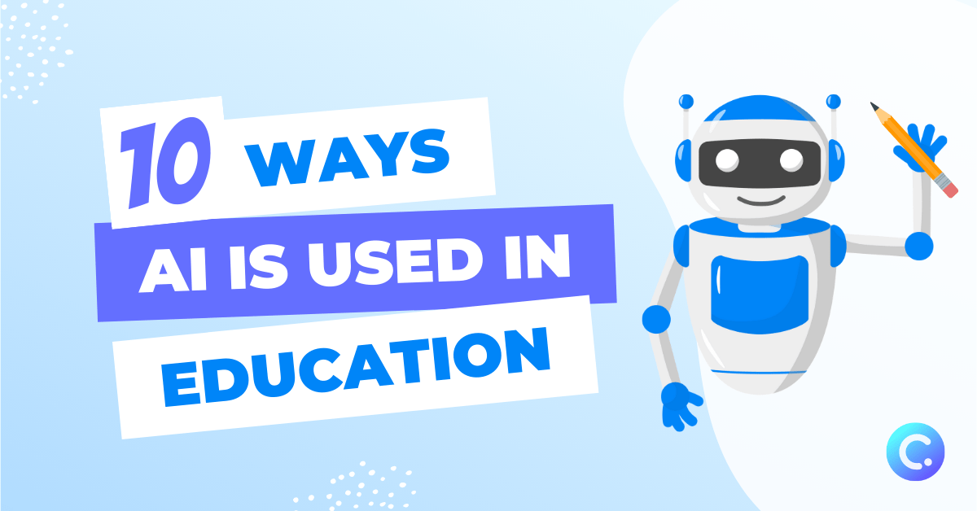
10 ways AI is used in Eudcation
Couse and lesson Creation
Differentiated Learning - teachers can design customized learning paths for their students
Auto Grading - AI can automate this process by grading written assignments
Pinpointing Knowledge Gaps - AI can analyze student data to identify skill and knowledge gaps.
Test Preparation - AI-powered test prep tools , analyze student data and provide targeted practice exercises to help students improve their test-taking skills.
Admin and Task Automation
Virtual, Personalized Tutoring
Providing Student Feedback - detailed explanations on how they can improve.
Adaptable, Equal Access - AI can help bridge the gap between different learning abilities and backgrounds.
Improved Virtual Learning - By using machine learning recommendation systems, AI-powered tools can provide personalized learning experiences by tracking progress and adapt the task

Slide 26
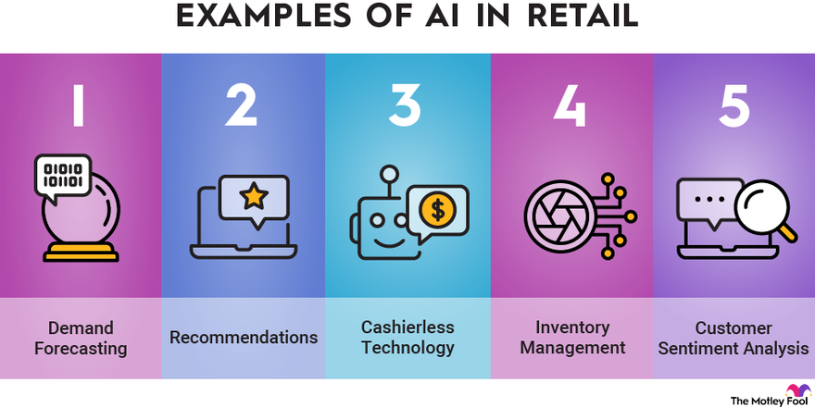
AI in Retail Business
Rapidly transforming the retail industry.
revolutionize the way retailers interact with customers, manage inventory, and optimize their operations
AI's ability to analyze vast amounts of data, identify patterns, and make predictions is proving invaluable in enhancing customer experiences, improving efficiency, and driving sales.

Slide 27
Key Applications of AI in Retail
Personalized Product Recommendations: AI algorithms can analyze customer data, including purchase history, browsing behavior, and demographics, to recommend personalized products that are likely to interest them. This technology enhances customer engagement and satisfaction, increasing the likelihood of purchases.
Demand Forecasting and Inventory Management: AI can predict customer demand for products with greater accuracy, enabling retailers to optimize inventory levels and reduce stockouts. This helps retailers avoid lost sales and minimize excess inventory costs.
Dynamic Pricing: AI can dynamically adjust product prices based on factors such as demand, competitor pricing, and market trends. This helps retailers maximize revenue and optimize profit margins.
Customer Service Chatbots and Virtual Assistants: AI-powered chatbots and virtual assistants can provide 24/7 customer support, answering questions, resolving issues, and providing product information. This enhances customer service availability and reduces the burden on human agents.
Fraud Detection and Prevention: AI can analyze transaction data to identify patterns that indicate fraudulent activity, such as unauthorized purchases or suspicious transactions. This helps retailers protect their revenue and reduce losses from fraud.
Store Layout and Design: AI can analyze customer movement patterns and preferences to optimize store layout and product placement. This can improve customer flow, increase product visibility, and enhance the overall shopping experience.
Targeted Marketing and Advertising: AI can analyze customer data to identify target audiences for marketing campaigns and personalize advertising messages. This ensures that marketing efforts are more effective and reach the right customers.
Supply Chain Optimization: AI can optimize supply chain operations by predicting delivery times, identifying potential disruptions, and recommending efficient transportation routes. This improves supply chain efficiency and reduces costs.
Visual Search and Product Discovery: AI-powered visual search tools enable customers to find products using images or text descriptions. This enhances product discovery and improves the shopping experience.
Augmented Reality (AR) and Virtual Reality (VR) Experiences: AI is enabling the development of AR and VR experiences in retail, allowing customers to virtually try on clothes, visualize furniture in their homes, or explore products in 3D. This enhances customer engagement and provides a more immersive shopping experience.

Slide 28
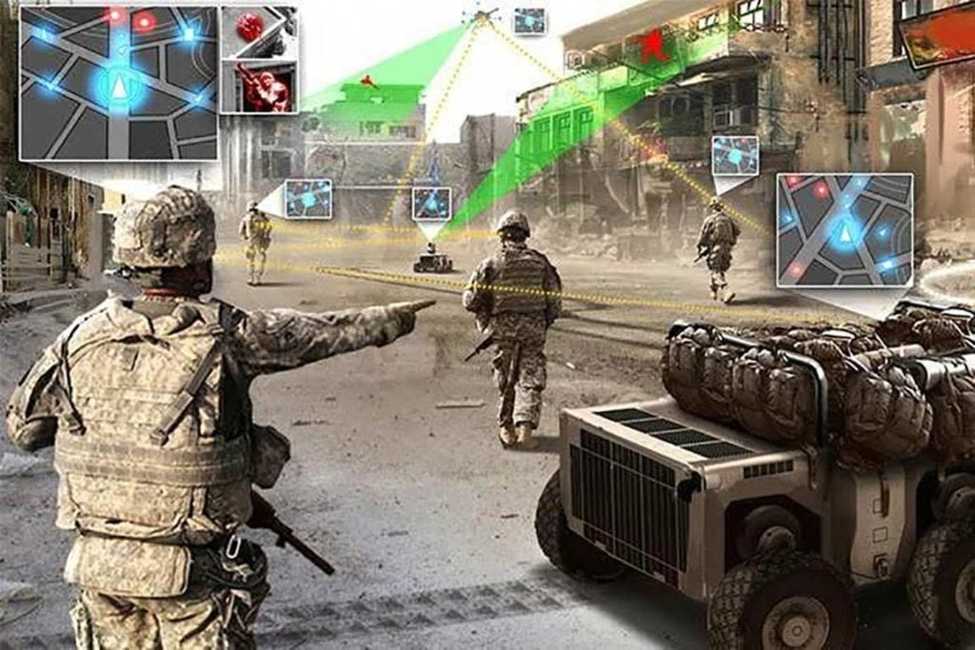
AI in Military
Intelligence, Surveillance, and Reconnaissance (ISR): AI algorithms can analyze data from satellites, drones, and other sensors to identify targets, track movements, and assess threats. This enhanced ISR capability provides commanders with a more comprehensive understanding of the battlefield.
Cybersecurity and Threat Detection: AI can analyze network traffic and identify anomalies that may indicate cyberattacks. This proactive threat detection helps protect military networks and sensitive information.
Predictive Maintenance and Logistics: AI can predict equipment failures in aircraft, vehicles, and other military assets, enabling preventive maintenance and reducing downtime. This predictive maintenance ensures operational readiness and reduces costs.
Target Recognition and Classification: AI algorithms can analyze images and videos from sensors to identify and classify targets, such as vehicles, personnel, and weapons. This enhanced target recognition improves situational awareness and targeting accuracy.
Decision Support Systems: AI can provide decision support to commanders by analyzing data, identifying patterns, and suggesting courses of action. This support helps commanders make informed decisions under pressure.

Slide 29
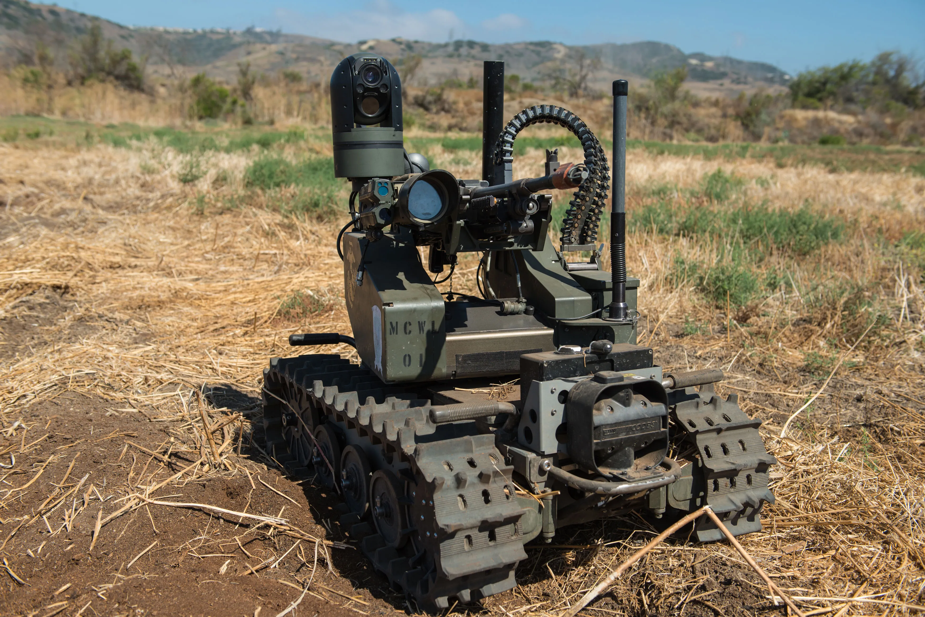
AI in Military
Autonomous Systems: AI is enabling the development of autonomous systems, such as unmanned aerial vehicles (UAVs), ground robots, and autonomous weapons systems. These systems can perform tasks without human intervention, extending military capabilities and reducing risks to personnel.
Training and Simulation: AI-powered training simulations provide realistic and immersive training environments for military personnel, enhancing their skills and preparedness for real-world scenarios.
Medical Diagnosis and Treatment: AI can assist medical personnel in diagnosing injuries, recommending treatments, and predicting patient outcomes. This support improves battlefield medicine and saves lives.
Translation and Communication: AI-powered translation tools facilitate communication between military personnel from different language backgrounds, enhancing cooperation and coordination.
Cyber Warfare and Electronic Warfare: AI is being used to develop offensive cyber capabilities and defend against cyberattacks. This ongoing arms race in the cyber domain highlights the growing importance of AI in military operations.

Slide 30
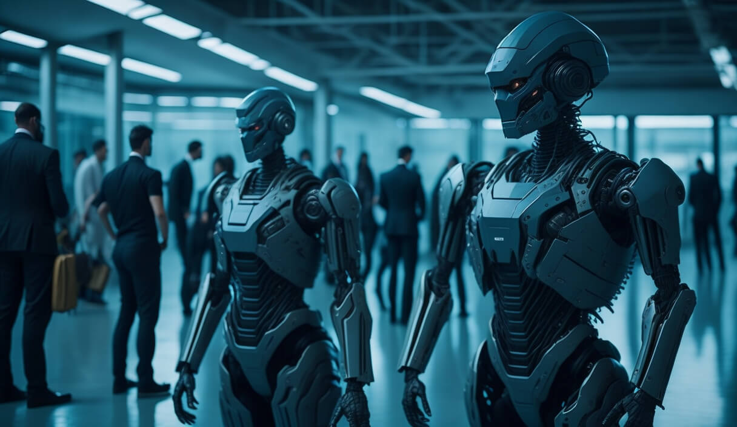
AI in Military
A steady increase in the integration of AI in military systems is likely
The various forms of AI have serious ramifications for warfighting applications.
AI will present new ethical questions in war, and deliberate attention can potentially mitigate the most-extreme risks.
Despite ongoing United Nations discussions, an international ban or other regulation on military AI is not likely in the near term.
International competition in military AI
Many countries are pursuing militarized AI technologies.
The potential proliferation of military AI to other state and nonstate actors is another area of concern.
The development of military AI presents a range of risks that need to be addressed
Ethical risks are important from a humanitarian standpoint.
Operational risks arise from questions about the reliability, fragility, and security of AI systems.
Strategic risks include the possibility that AI will increase the likelihood of war, escalate ongoing conflicts, and proliferate to malicious actors.

Slide 31
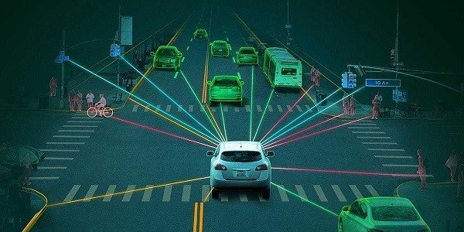
AI – The future of Driving
Seamless Autonomous Driving: Autonomous driving systems will become increasingly sophisticated, enabling vehicles to navigate complex environments and handle a wide range of driving scenarios with minimal human intervention.
Enhanced Safety and Efficiency: AI will play a crucial role in enhancing road safety by reducing human error, improving traffic flow, and optimizing vehicle performance.
Personalized Driving Experiences: AI will enable vehicles to personalize driving experiences based on individual preferences, adjusting settings, providing entertainment, and tailoring navigation to suit the driver's needs.
Predictive Maintenance and Repair: AI will monitor vehicle systems and predict potential failures, enabling proactive maintenance to prevent breakdowns and reduce downtime.
Cooperative Vehicle-to-Everything (V2X) Communication: AI-powered V2X communication will enable vehicles to exchange information with each other, infrastructure, and pedestrians, improving situational awareness and preventing collisions.
Shared Mobility and Ride-Sharing: AI will facilitate the growth of shared mobility and ride-sharing services, optimizing routes, matching riders, and managing vehicle fleets efficiently.
Urban Planning and Traffic Management: AI will inform urban planning and traffic management strategies, optimizing road infrastructure, reducing congestion, and improving air quality.
New Forms of Vehicle Ownership and Usage: AI will enable new forms of vehicle ownership and usage, such as subscription services and autonomous taxis, providing greater flexibility and accessibility.
Integration with Smart Homes and Cities: AI will connect vehicles with smart homes and cities, enabling seamless integration with home automation systems, traffic management systems, and smart infrastructure.
Evolution of Driving Skills and Education: AI will transform driving education, providing personalized instruction, adapting to individual learning styles, and preparing drivers for the future of autonomous mobility.

Slide 32
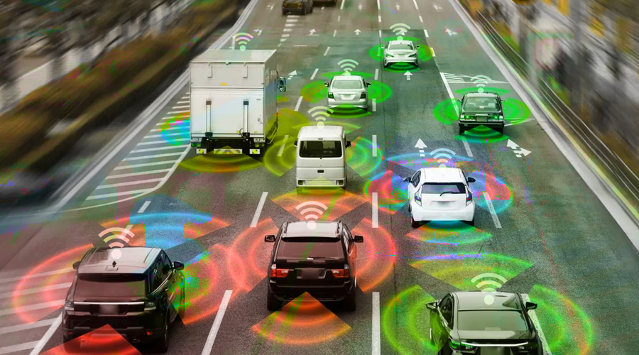
Autonomous Driving Systems
Perceiving the Environment:
Sensor Fusion: AI algorithms combine data from multiple sensors, such as cameras, radar, and lidar, to create a comprehensive understanding of the surrounding environment.
Object Detection and Classification: AI algorithms identify and classify objects in the environment, such as vehicles, pedestrians, traffic signs, and lane markings.
Semantic Segmentation: AI algorithms can distinguish between different types of objects, such as cars, trucks, bicycles, and pedestrians, providing a deeper understanding of the scene.
Localization and Mapping:
Simultaneous Localization and Mapping (SLAM): AI algorithms enable autonomous vehicles to accurately determine their position and orientation while simultaneously creating a map of the environment.
High-Definition (HD) Mapping: AI-powered mapping techniques create detailed and accurate maps of the environment, including road geometry, landmarks, and traffic patterns.
Real-time Localization: AI algorithms continuously update the vehicle's position and orientation, ensuring precise navigation even in dynamic environments.

Slide 33
Autonomous Driving Systems
Decision-Making and Planning:
Path Planning: AI algorithms determine the optimal path for the vehicle to reach its destination, considering factors like traffic conditions, road rules, and safety constraints.
Trajectory Planning: AI algorithms generate detailed trajectories for the vehicle, including speed, acceleration, and steering commands, to follow the planned path smoothly.
Predictive Driving: AI algorithms anticipate the behavior of other road users and predict possible scenarios, enabling the vehicle to make proactive decisions to avoid collisions.
Control and Execution:
Sensorimotor Control: AI algorithms translate high-level decisions into low-level control signals for the vehicle's actuators, such as steering, braking, and acceleration.
Adaptive Control: AI algorithms adjust control strategies in real-time based on changing environmental conditions and sensor inputs, ensuring stable and responsive behavior.
Fault Detection and Recovery: AI algorithms monitor the vehicle's systems and detect potential faults, enabling autonomous recovery or safe shutdown in case of emergencies.

Slide 34
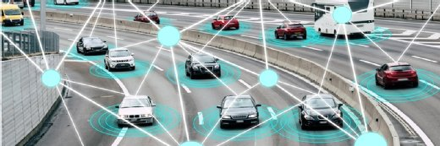
AI in Self Driving Vehicles
Perception: AI algorithms analyze data from sensors like cameras, lidar, and radar to create a comprehensive understanding of the vehicle's surroundings. This includes identifying and classifying objects like vehicles, pedestrians, traffic signs, and lane markings.
Localization: AI algorithms determine the vehicle's precise position and orientation within the environment using techniques like GPS, inertial navigation systems, and sensor fusion.
Path Planning: AI algorithms plan the vehicle's route to reach its destination, considering factors like traffic conditions, road rules, and safety constraints.
Motion Planning: AI algorithms generate detailed trajectories for the vehicle, including speed, acceleration, and steering commands, to follow the planned path smoothly.
Control: AI algorithms translate high-level decisions into low-level control signals for the vehicle's actuators, such as steering, braking, and acceleration.

Slide 35
SDV Benefits and Challenges
Benefits of AI-powered SDVs:
Enhanced Safety: AI can reduce human error, a leading cause of accidents, improving overall road safety.
Increased Efficiency: AI can optimize traffic flow, reduce congestion, and improve fuel efficiency.
Accessibility: AI can provide mobility to individuals who cannot drive themselves, such as the elderly and people with disabilities.
New Mobility Services: AI can enable new mobility services like autonomous taxis and ride-sharing, offering greater flexibility and convenience.
Reduced Environmental Impact: AI can optimize driving patterns and reduce fuel consumption, contributing to a more sustainable transportation system.
Challenges of AI-powered SDVs:
Technical Complexity: Developing and deploying reliable AI systems for SDVs is a complex and expensive endeavor.
Regulatory Uncertainty: Regulatory frameworks for SDVs are still evolving, creating uncertainty for manufacturers and operators.
Public Acceptance: Gaining public trust and acceptance for SDVs requires addressing concerns about safety, liability, and ethical considerations.
Infrastructure Adaptation: In some cases, infrastructure may need to be adapted to accommodate SDVs, such as adding dedicated lanes or providing better communication networks.
Edge Cases and Unforeseen Scenarios: AI systems need to be able to handle a wide range of edge cases and unforeseen scenarios, including unusual weather conditions, road hazards, or unexpected human behavior.

Slide 36
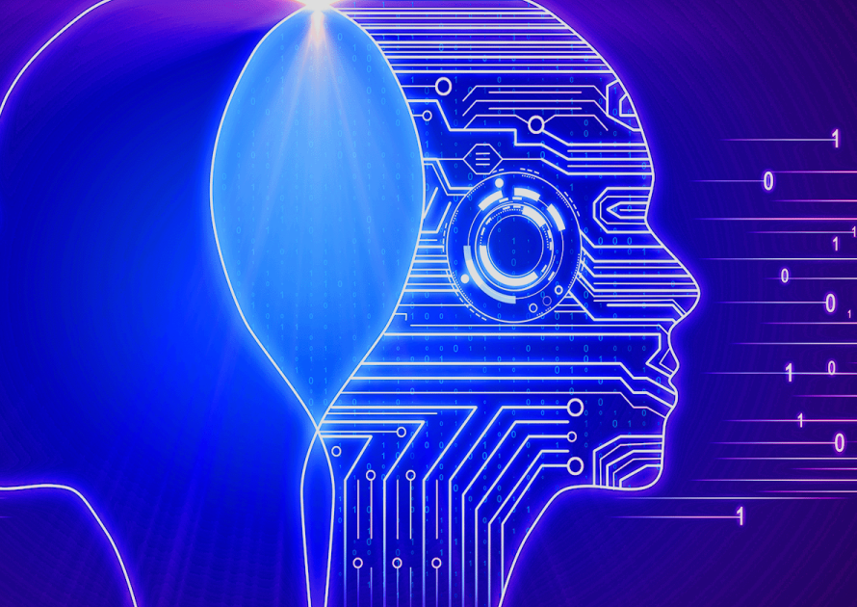
Enhanced Human-Machine Collaboration
Augmented Intelligence
Human-Centric Design
Augmented intelligence is a subset of artificial intelligence in which AI technologies assist humans rather than replace them. It's typically done using machine learning to analyze data and help humans make smarter decisions. Humans can use augmented intelligence to enhance their capabilities and tools.

Slide 37
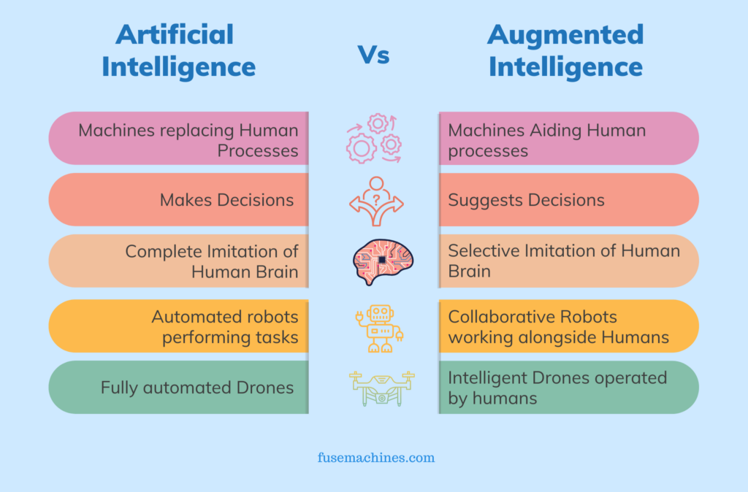
AI and Augmented Intelligence
Subset of artificial intelligence (AI) that focuses on enhancing human cognitive capabilities rather than replacing them
Create a synergistic relationship between humans and AI, where AI tools augment and amplify human intelligence
Leads to better decision-making, problem-solving, and overall performance.
Designed to collaborate with humans, providing real-time assistance, insights, and recommendations
Allows humans to leverage the power of AI while maintaining control over the decision-making process

Slide 38
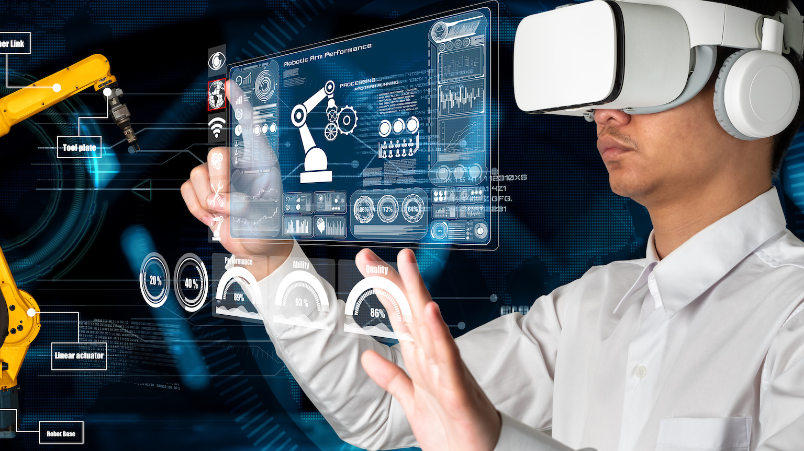
Characteristics of augmented intelligence
Human-centered design: Augmented intelligence systems are designed with human users at the forefront, considering their cognitive abilities, limitations, and workflow preferences.
Adaptive and personalized: Augmented intelligence systems adapt to individual user needs and preferences, providing personalized assistance and recommendations tailored to their specific context and task.
Real-time support: Augmented intelligence systems provide real-time assistance, offering insights, recommendations, and feedback as users are working on tasks.
Explainable and transparent: Augmented intelligence systems strive to be explainable and transparent, allowing users to understand the reasoning behind their recommendations and decisions.
Cognitive augmentation: Augmented intelligence systems aim to augment human cognitive abilities, such as pattern recognition, memory, and decision-making.

Slide 39
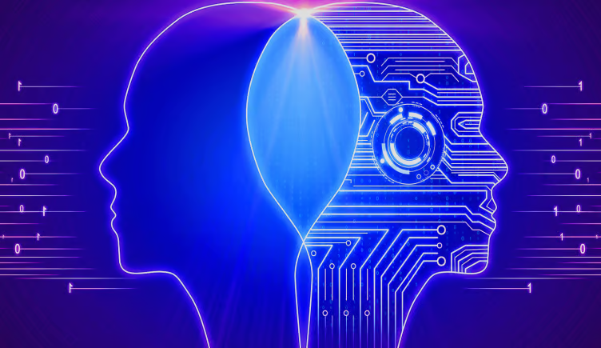
Applications of Augmented Intelligence
Healthcare: Augmented intelligence can assist medical professionals in diagnosis, treatment planning, and patient monitoring, leading to improved patient outcomes.
Education: Augmented intelligence can personalize learning experiences, provide real-time feedback, and adapt to individual student needs, enhancing the learning process.
Finance: Augmented intelligence can assist financial analysts in risk assessment, market forecasting, and investment decisions, improving financial performance.
Customer service: Augmented intelligence can power chatbots and virtual assistants, providing 24/7 support, answering questions, and resolving customer issues.
Manufacturing: Augmented intelligence can optimize supply chains, predict equipment failures, and improve production efficiency.
Design and creativity: Augmented intelligence can assist designers in generating ideas, visualizing concepts, and refining their work.
Research and development: Augmented intelligence can analyze vast amounts of data, identify patterns, and generate hypotheses, accelerating scientific discoveries.

Slide 40
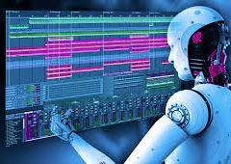
AI in Creativity
Transforming the field of creativity, enabling new forms of artistic expression
Augmenting human creativity in a variety of domains.
AI's ability to process vast amounts of data, identify patterns, and generate creative outputs is opening up new possibilities for artists, designers, and creative professionals.

Slide 41
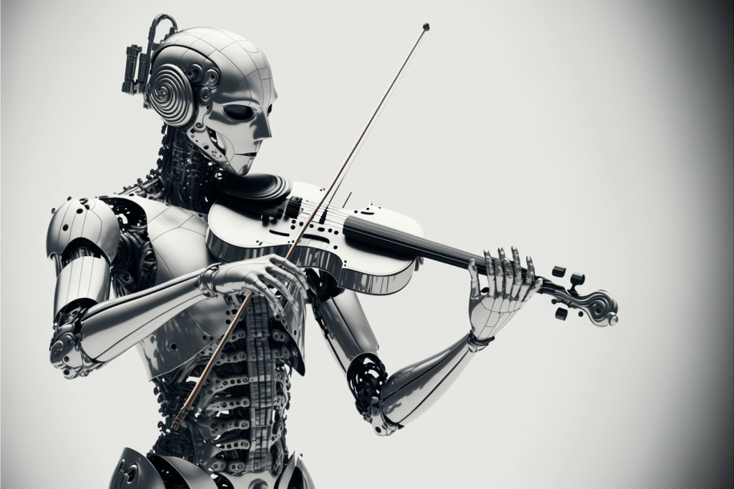
AI influencing creativity:
Generative Art and Music: AI algorithms can generate original and aesthetically pleasing art, music, and poetry. These AI-generated creations can mimic existing styles or explore new artistic dimensions, pushing the boundaries of creative expression.
Creative Writing and Storytelling: AI can assist writers in crafting stories, generating ideas, and developing character arcs. AI-powered writing tools can provide feedback, suggest plot twists, and even generate entire narratives based on prompts or outlines.
Design and Fashion: AI is being used to design products, clothing, and accessories. AI algorithms can analyze trends, identify patterns, and generate creative designs that are both aesthetically pleasing and functionally effective.
Curating and Recommending Creative Content: AI can help users discover and connect with creative content that aligns with their interests. AI-powered recommendation systems can analyze user preferences, identify similar works, and suggest relevant content based on their past interactions.
Personalization and Customization: AI can personalize creative experiences for individual users. AI algorithms can adapt to user preferences, generate personalized art, music, or stories, and tailor creative content to specific tastes and styles.
Augmenting Human Creativity: AI can augment human creativity by providing tools and assistance that enhance human capabilities. AI-powered tools can help artists generate ideas, refine their work, and expand their creative horizons.

Slide 42


AI in Creativity - Examples
AI-generated Art and Music - generated image .. …“Kangaroo carrying a briefcase in Dublin
Creative Writing and Design – ChatGPT Story

Slide 43
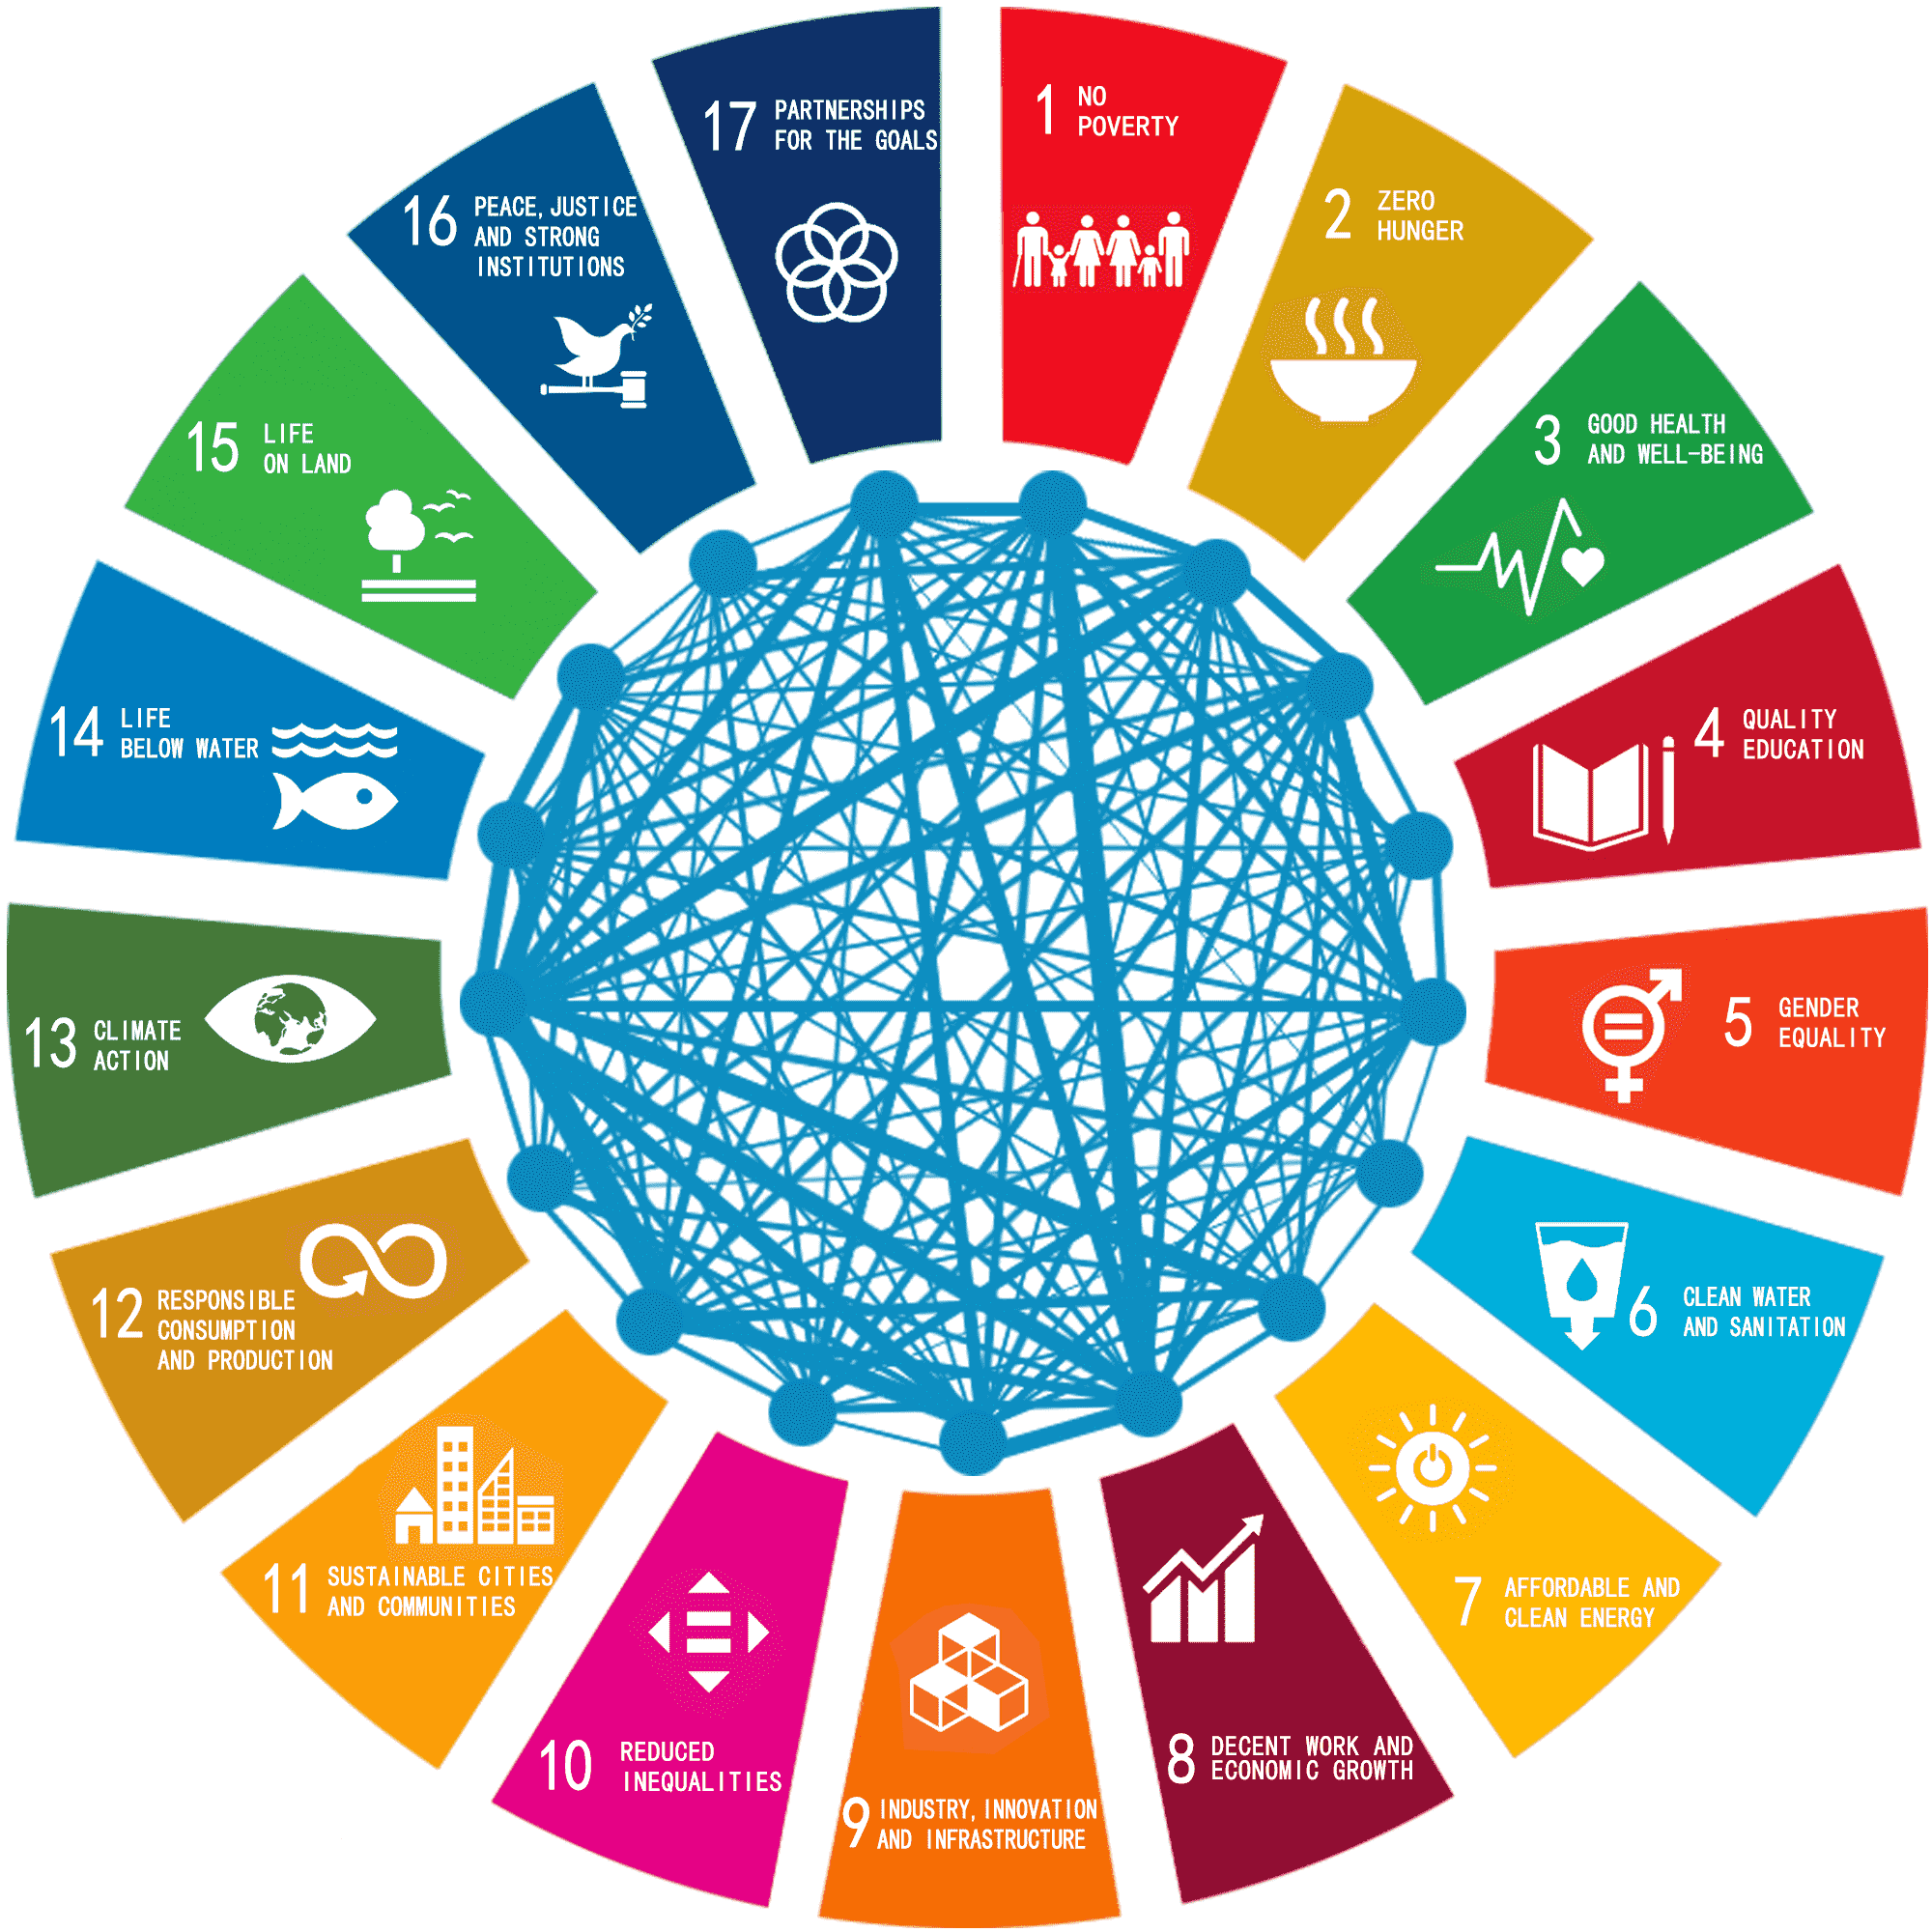
AI and Climate Change
Environmental Monitoring
Energy Optimization
Climate Modeling

Slide 44
AI in Climate Change
Artificial intelligence (AI) has the potential to revolutionize our approach to climate change, offering innovative solutions to mitigate its effects and adapt to its impacts. AI can be applied across various sectors to address different aspects of climate change, from reducing greenhouse gas emissions to enhancing disaster preparedness and resilience.
Mitigating Climate Change with AI
Energy Efficiency: AI can optimize energy consumption in buildings, industries, and transportation systems, reducing energy waste and lowering greenhouse gas emissions.
Renewable Energy Integration: AI can improve the efficiency and integration of renewable energy sources like solar and wind power, increasing their contribution to the energy grid.
Carbon Capture and Storage: AI can optimize carbon capture and storage (CCS) technologies, capturing and storing carbon emissions from power plants and industrial processes.
Precision Agriculture: AI can optimize agricultural practices, reducing fertilizer use, improving irrigation efficiency, and increasing crop yields, leading to lower greenhouse gas emissions from agriculture.

Slide 45
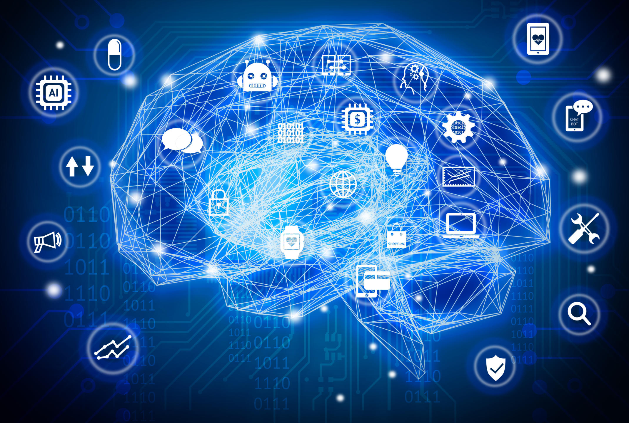
AI DEEP LEARNING
Deep Learning - type of machine learning that uses artificial neural networks (ANNs) to learn from data
ANNs are inspired by the structure and function of the human brain, with interconnected layers of neurons that process and transmit information.
Able to learn complex patterns and relationships in data, making them well-suited for tasks such as image recognition, natural language processing, and speech recognition

Slide 46
Components of Deep Learning
Artificial Neurons: Artificial neurons are the basic building blocks of ANNs. They are mathematical functions that receive input signals, process them, and produce an output signal.
Activation Functions: Activation functions introduce non-linearity into the network, allowing it to learn complex patterns. Common activation functions include sigmoid, tanh, and ReLU.
Layers: ANNs are composed of multiple layers of neurons, interconnected in a directed manner. Each layer performs a specific computation and passes its output to the next layer.
Training: Deep learning models are trained by feeding them data and adjusting their parameters (weights and biases) to minimize an error function. This process is called optimization.
Loss Function: The loss function quantifies the error between the model's predictions and the actual labels or targets. Common loss functions include mean squared error (MSE) and cross-entropy.

Slide 47
Applications of Deep Learning
Image Recognition: Deep learning has revolutionized image recognition, enabling computers to identify and classify objects in images with remarkable accuracy. This technology is used in applications like facial recognition, self-driving cars, and medical image analysis.
Natural Language Processing (NLP): Deep learning is transforming NLP by enabling machines to understand and generate human language. This technology is used in applications like machine translation, chatbots, and sentiment analysis.
Speech Recognition: Deep learning has significantly improved speech recognition accuracy, enabling computers to transcribe spoken language accurately. This technology is used in applications like voice assistants, dictation software, and language learning tools.
Recommendation Systems: Deep learning is powering recommendation systems that predict user preferences and suggest relevant products, movies, music, and other items.
Anomaly Detection: Deep learning can identify anomalies in data, such as fraudulent transactions, network intrusions, or medical abnormalities.

Slide 48
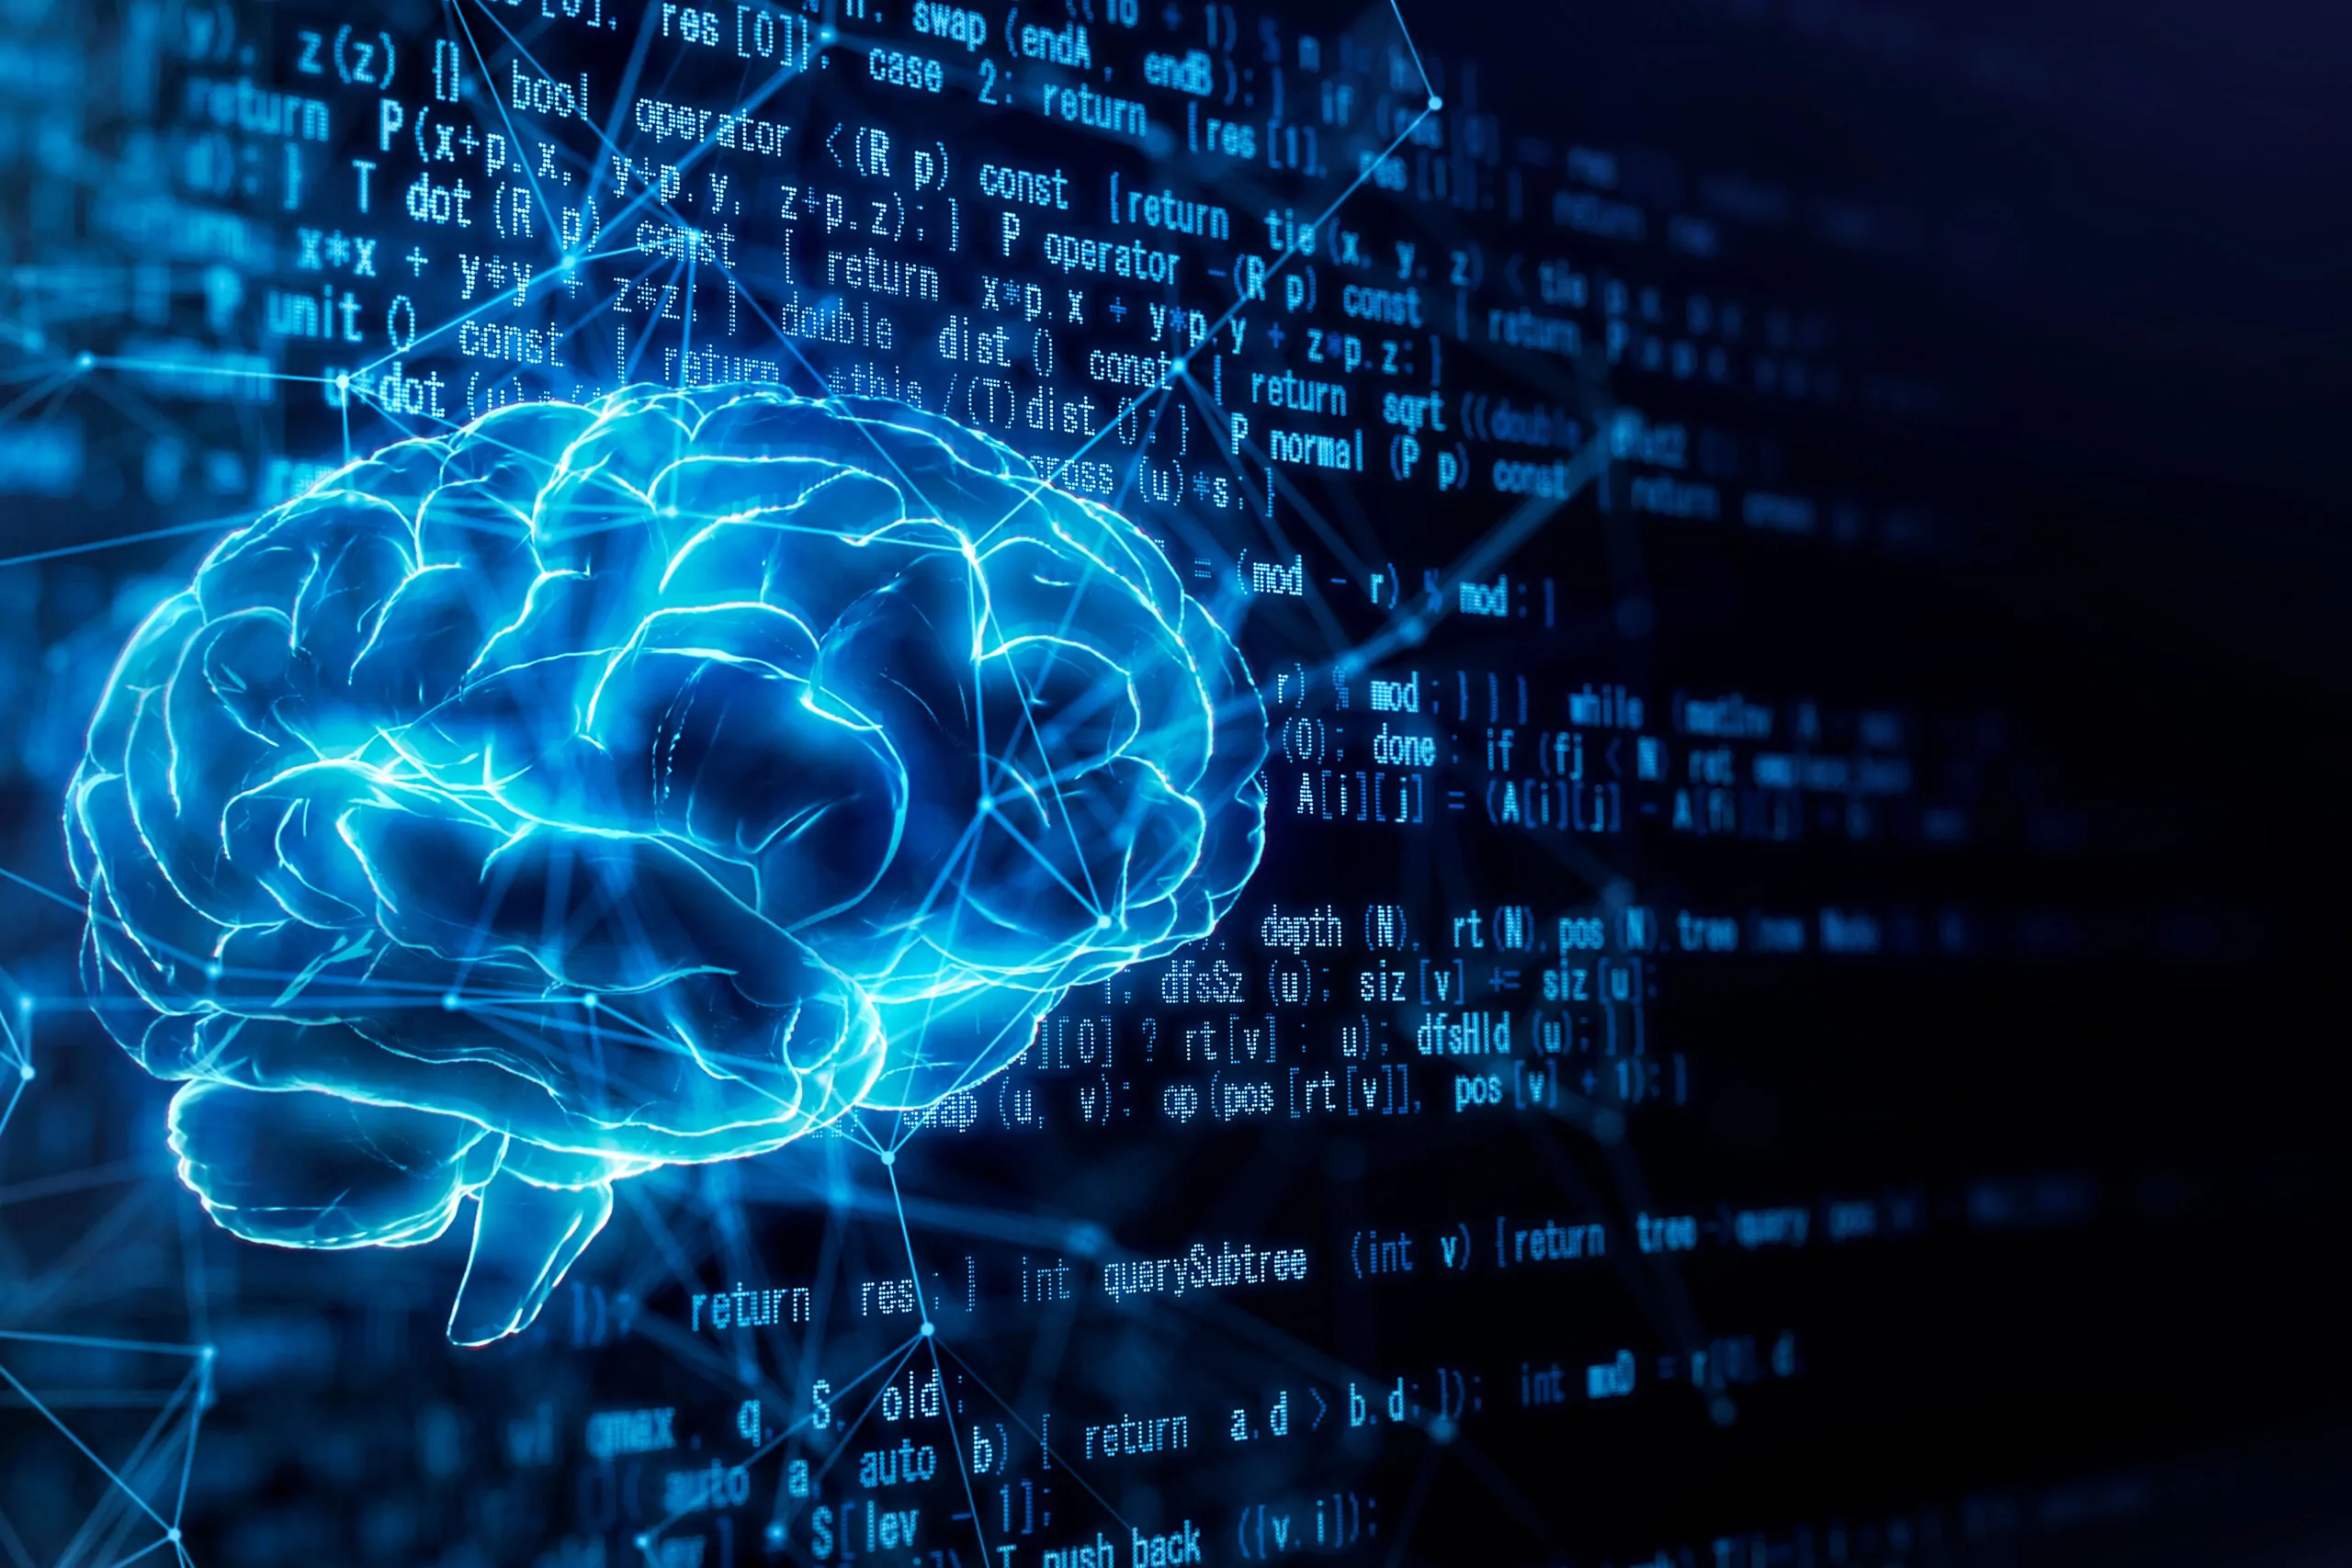
Breakthroughs in Deep Learning
GPT-3 and Language Models *Chat GPT *
Generative Pretrained Transformer 3, is a large language model (LLM) chatbot developed by OpenAI
Transformer Architectures
Transformer architectures are a powerful and versatile type of neural network architecture that have revolutionized the field of natural language processing (NLP).
Reinforcement Learning
Type of machine learning that enables an agent to interact with its environment and learn by trial and error.

Slide 49
Question – Me and AI in the Future ?
Question:
How does the class think AI will affect them in the future ?
Education
Medicine
Driving Systems

Slide 50
What ethical challenges face us ?
QUESTION:
Can the class list all the potential ethical problems AI may introduce ?

Slide 51
Ethical AI and Responsible Development
Regulatory Approaches to AI:
Risk-Based Regulation: Categorize AI systems based on their potential risks and apply appropriate regulatory measures accordingly.
Sector-Specific Regulation: Develop specific regulations for high-risk AI applications in sensitive sectors like healthcare, finance, and transportation.
Data Governance and Privacy: Implement robust data governance frameworks to protect individual privacy and ensure responsible data use in AI development.
International Cooperation: Foster international cooperation and harmonization of AI regulations to address global challenges and promote consistent standards.
Governance Frameworks for AI:
Ethics Principles: Establish clear ethical principles for AI development and deployment, ensuring alignment with human values and societal norms.
Multi stakeholder Engagement: Encourage multistakeholder engagement, involving diverse perspectives from industry, academia, civil society, and government.
Public Awareness and Education: Promote public awareness and understanding of AI, fostering informed discussions and decision-making.
Impact Assessment and Monitoring: Continuously assess the impact of AI systems and monitor their performance, identifying and addressing potential risks and unintended consequences.
Adaptation and Evolution: Ensure that AI regulation and governance frameworks can adapt to the rapid pace of technological advancements.

Slide 52
AI : Ethical Concerns
Bias and Fairness:
Algorithmic Bias: AI systems can inherit and perpetuate biases present in their training data, leading to discriminatory outcomes, particularly against underrepresented groups.
Fairness: Ensuring fair and equitable treatment for all individuals is a challenge, and defining what constitutes fairness can be subjective.
Privacy:
Data Privacy: AI systems often require large amounts of data for training, raising concerns about the collection, storage, and use of personal information without adequate consent.
Surveillance: The use of AI in surveillance technologies can infringe on individuals' privacy rights, leading to concerns about mass surveillance and loss of personal freedom.
Transparency:
Explainability: Many AI algorithms, especially deep learning models, operate as "black boxes," making it challenging to understand how they arrive at specific decisions. Lack of transparency can erode trust in AI systems.
Accountability: Determining responsibility when AI systems make errors or exhibit biased behavior is complex and raises questions about legal and ethical accountability.
Job Displacement and Economic Inequality:
Automation of Jobs: The widespread adoption of AI could lead to job displacement, particularly in routine and repetitive tasks, potentially exacerbating economic inequality.
Skills Gap: The rapid pace of technological change may create a gap between the skills demanded by the job market and those possessed by the workforce.

Slide 53
AI : Ethical Concerns
Security:
Vulnerabilities: AI systems may be susceptible to attacks, and the malicious use of AI could have serious consequences, including the generation of deepfakes or the manipulation of decision-making processes.
Adversarial Attacks: AI models can be manipulated by introducing carefully crafted inputs, leading to incorrect or unintended outputs.
Autonomous Systems:
Safety: Concerns arise with the deployment of autonomous AI systems, such as self-driving cars and drones, regarding their ability to make ethically sound decisions in complex and unpredictable situations.
Lethal Autonomous Weapons: The development of AI-powered weapons capable of autonomous decision-making raises ethical questions about the potential for abuse and lack of human control.
Social Impact:
Inequality: AI technologies could exacerbate existing social inequalities by favoring certain groups or nations over others, both in terms of access to technology and its benefits.
Manipulation and Propaganda: AI-powered tools can be used to spread misinformation, manipulate public opinion, and influence political processes.
Environmental Impact:
Resource Intensiveness: Training sophisticated AI models, especially large neural networks, requires substantial computational resources, contributing to significant energy consumption and environmental impact.

Slide 54
Challenges and Considerations for the Future
Bias and Fairness: AI systems can perpetuate and amplify existing biases in the data they are trained on, leading to unfair and discriminatory outcomes. It is crucial to mitigate bias in AI systems to ensure they treat all individuals fairly and equitably.
Explainability and Transparency: AI systems can be complex and opaque, making it difficult to understand how they make decisions. This lack of transparency can lead to mistrust and hinder accountability. Enhancing explainability and transparency in AI systems is essential for building trust and ensuring responsible use.
Privacy and Data Protection: AI systems often rely on vast amounts of personal data, raising concerns about privacy and data protection. Robust data governance frameworks are needed to protect individual privacy and ensure responsible data use in AI development.
Job Displacement and Economic Impact: AI automation has the potential to displace certain jobs, raising concerns about unemployment and economic disruption. It is crucial to proactively address these challenges through workforce retraining, education, and social safety nets.
Safety and Security: AI systems can pose risks to safety and security, particularly in areas like autonomous vehicles and cybersecurity. Rigorous testing, risk assessment, and security measures are needed to ensure AI systems are safe and reliable.
Ethical Considerations and Human Control: AI systems raise ethical questions about human autonomy, responsibility, and control. It is essential to establish clear ethical principles and maintain human oversight to ensure AI is aligned with human values and societal norms.
Global Cooperation and Standardization: AI development and deployment transcend national borders, requiring international cooperation and standardization to address shared challenges and promote consistent ethical standards.
Continuous Monitoring and Adaptation: AI technology is rapidly evolving, requiring ongoing monitoring and adaptation of regulations and governance frameworks to keep pace with technological advancements.
Public Awareness and Education: Fostering public awareness and understanding of AI is crucial for informed discussions, decision-making, and building trust in AI technologies.
Addressing the Digital Divide: AI deployment should consider the digital divide and ensure that its benefits are accessible to all individuals, regardless of their socioeconomic background or geographical location.

Slide 55
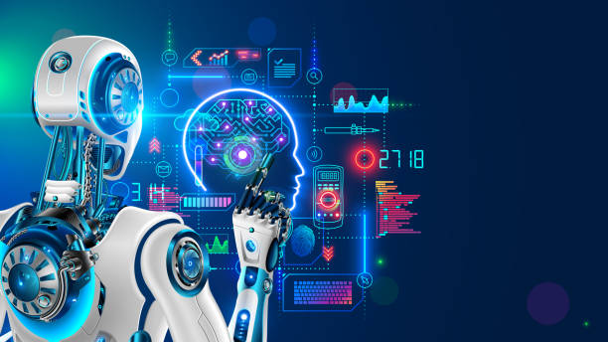
Some Cool Facts!
AI-enabled devices are everywhere
AI is smarter than humans, sort of!
AI can diagnose diseases
AI can understand natural language
AI is Self-Learning
AI is Improving Automation
AI improves the quality of education
Utilizing AI enhances security measures
AI Can Make Businesses More Efficient
AI Can Improve Human Lives

Slide 56
Conclusion
Enhanced Decision-Making: AI can analyze vast amounts of data and identify patterns that would be impossible for humans to detect. This ability to extract insights from data can help us make better decisions in various aspects of our lives, from healthcare to business to personal choices.
Automation of Repetitive Tasks: AI can automate repetitive tasks, freeing up human time and resources for more creative and meaningful pursuits. This automation can lead to increased productivity, reduced costs, and improved quality of life.
Personalized Experiences: AI can tailor experiences to individual preferences and behaviors, providing a more personalized and engaging experience for users. This personalization can be seen in areas like product recommendations, search results, and learning experiences.
Augmented Human Capabilities: AI can augment human capabilities, extending our abilities beyond what we could achieve alone. This augmentation can be seen in areas like medical diagnosis, scientific research, and creative endeavors.
Addressing Global Challenges: AI can help us address some of the world's most pressing challenges, such as climate change, poverty, and disease. AI-powered solutions can optimize resource allocation, improve healthcare delivery, and develop sustainable practices.
Unlocking New Frontiers: AI has the potential to unlock new frontiers in various fields, from space exploration to artificial general intelligence. These advancements could lead to breakthroughs that were previously unimaginable, shaping our future in ways we can only begin to foresee.

Slide 57
References
https://www.thinknexttraining.com/top-10-cool-facts-about-artificial-intelligence.aspx
https://chat.openai.com/c/2016f950-b011-4042-9511-8afbd2499aa8
https://articlefiesta.com/blog/how-will-artificial-intelligence-will-change-the-world-in-2023/?amp=1&gad_source=1&gclid=Cj0KCQiA6vaqBhCbARIsACF9M6nlNV621MVqpvFdKgRzy69j6odg-n3RcR7kbrSoiMdylls_TeSbnfMaAuoIEALw_wcB
https://www.rand.org/pubs/research_reports/RR3139-1.html
https://www.classpoint.io/blog/10-ways-how-ai-is-used-in-education

Slide 58
Transformer Architecture
Transformer architectures are a powerful and versatile type of neural network architecture that have revolutionized the field of natural language processing (NLP). They are particularly well-suited for tasks that involve understanding long-range dependencies between words in a sentence, such as machine translation and text summarization.
Key Features of Transformer Architectures:
Self-Attention Mechanism: Transformers rely on a mechanism called self-attention, which allows the model to learn relationships between different parts of the input text. This is in contrast to traditional recurrent neural networks (RNNs), which can only learn relationships between nearby words.
Encoder-Decoder Architecture: Transformers typically consist of an encoder and a decoder. The encoder takes the input text and transforms it into a representation that captures the meaning of the text. The decoder then takes this representation and generates the output text.
Positional Encoding: Transformers use positional encoding to distinguish between different positions in the input text. This is important because the order of words in a sentence matters for its meaning.
Applications of Transformer Architectures:
Machine Translation: Transformers have achieved state-of-the-art results on machine translation tasks. They are able to capture long-range dependencies between words in a sentence, which is essential for accurately translating between languages.
Text Summarization: Transformers are also used for text summarization tasks. They are able to extract the most important information from a text and generate a shorter summary that captures the main points.
Question Answering: Transformers can be used to answer questions about a piece of text. They can understand the context of the question and identify the relevant information in the text.
Natural Language Generation: Transformers can be used to generate natural language text. They can be used to create chatbots, write creative text formats, or translate languages.
Impact of Transformer Architectures:
Transformer architectures have had a profound impact on the field of NLP. They have led to significant improvements in the performance of many NLP tasks, and they have opened up new possibilities for research in the field.
Here are some of the key benefits of using transformer architectures:
Improved Accuracy: Transformers have been shown to achieve state-of-the-art results on a variety of NLP tasks.
Scalability: Transformers can be scaled to handle large amounts of data, which makes them well-suited for real-world applications.
Versatility: Transformers can be used for a wide variety of NLP tasks, from machine translation to text summarization to question answering.

Slide 59
GPT-3
It is a powerful tool that can generate human-quality text, translate languages, write different kinds of creative content, and answer your questions in an informative way. GPT-3 is trained on a massive dataset of text and code, which allows it to learn the patterns and relationships between words and concepts. This makes it possible for GPT-3 to generate text that is both coherent and grammatically correct.
GPT-3 has been used in a variety of applications, including:
Chatbots: GPT-3 can be used to create chatbots that can hold conversations with humans in a natural way.
Machine translation: GPT-3 can be used to translate languages, and it has been shown to be more accurate than traditional machine translation methods.
Creative writing: GPT-3 can be used to generate different kinds of creative content, such as poems, code,scripts, musical pieces, email, letters, etc.
Answering questions: GPT-3 can be used to answer questions in an informative way, even if they are open ended, challenging, or strange.
GPT-3 is a powerful tool that has the potential to revolutionize the way we interact with computers. However, it is important to use GPT-3 responsibly and to be aware of its limitations.
Here are some of the limitations of GPT-3:
GPT-3 can be biased: GPT-3 is trained on a massive dataset of text and code, which may reflect the biases of the real world. This can lead to GPT-3 generating biased or discriminatory text.
GPT-3 can be easily fooled: GPT-3 is a powerful tool, but it can also be easily fooled. For example, GPT-3 can be tricked into generating incorrect or harmful text if it is given misleading or biased information.
GPT-3 is still under development: GPT-3 is a powerful tool, but it is still under development. This means that it is not always reliable or accurate.
Overall, GPT-3 is a powerful tool with the potential to revolutionize the way we interact with computers. However, it is important to use GPT-3 responsibly and to be aware of its limitations.

